Slide 1
Performance comparison and analysis of Linux block I/O schedulers on SSD
Yunus Ozen, Abdullah Yildirim.
2020. 01. 12
Presentation by Lee, Sounghyoun
leesh812@dankook.ac.kr

Slide 2
Introduction
Scheduler
Analysis and Results
Conclusion

Slide 3
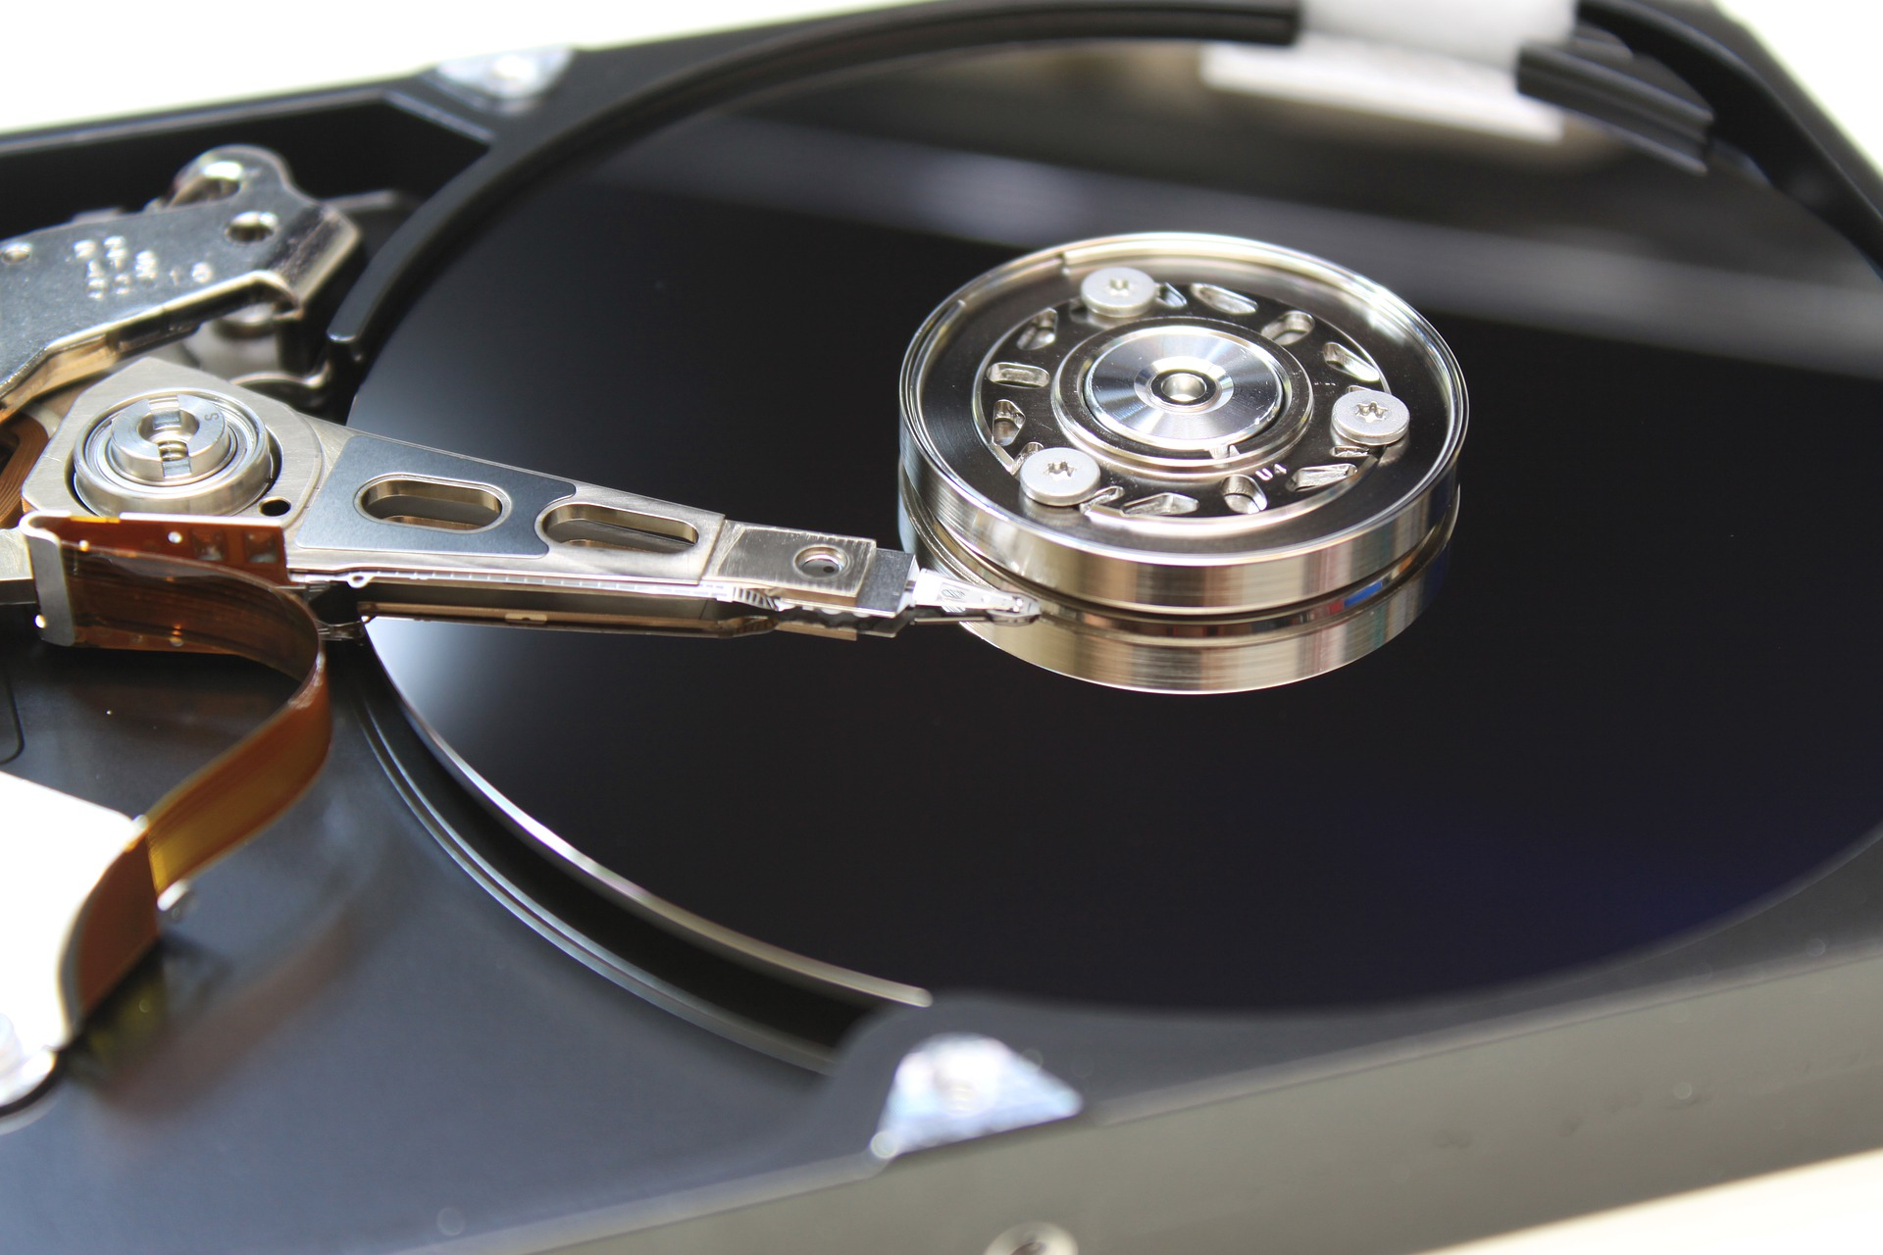
1. Introduction
Google Finance
1. Introduction
Performance comparison and analysis of Linux block I/O schedulers on SSD

Slide 4
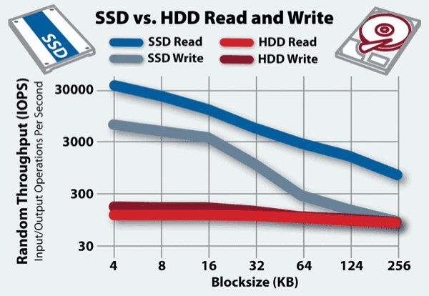

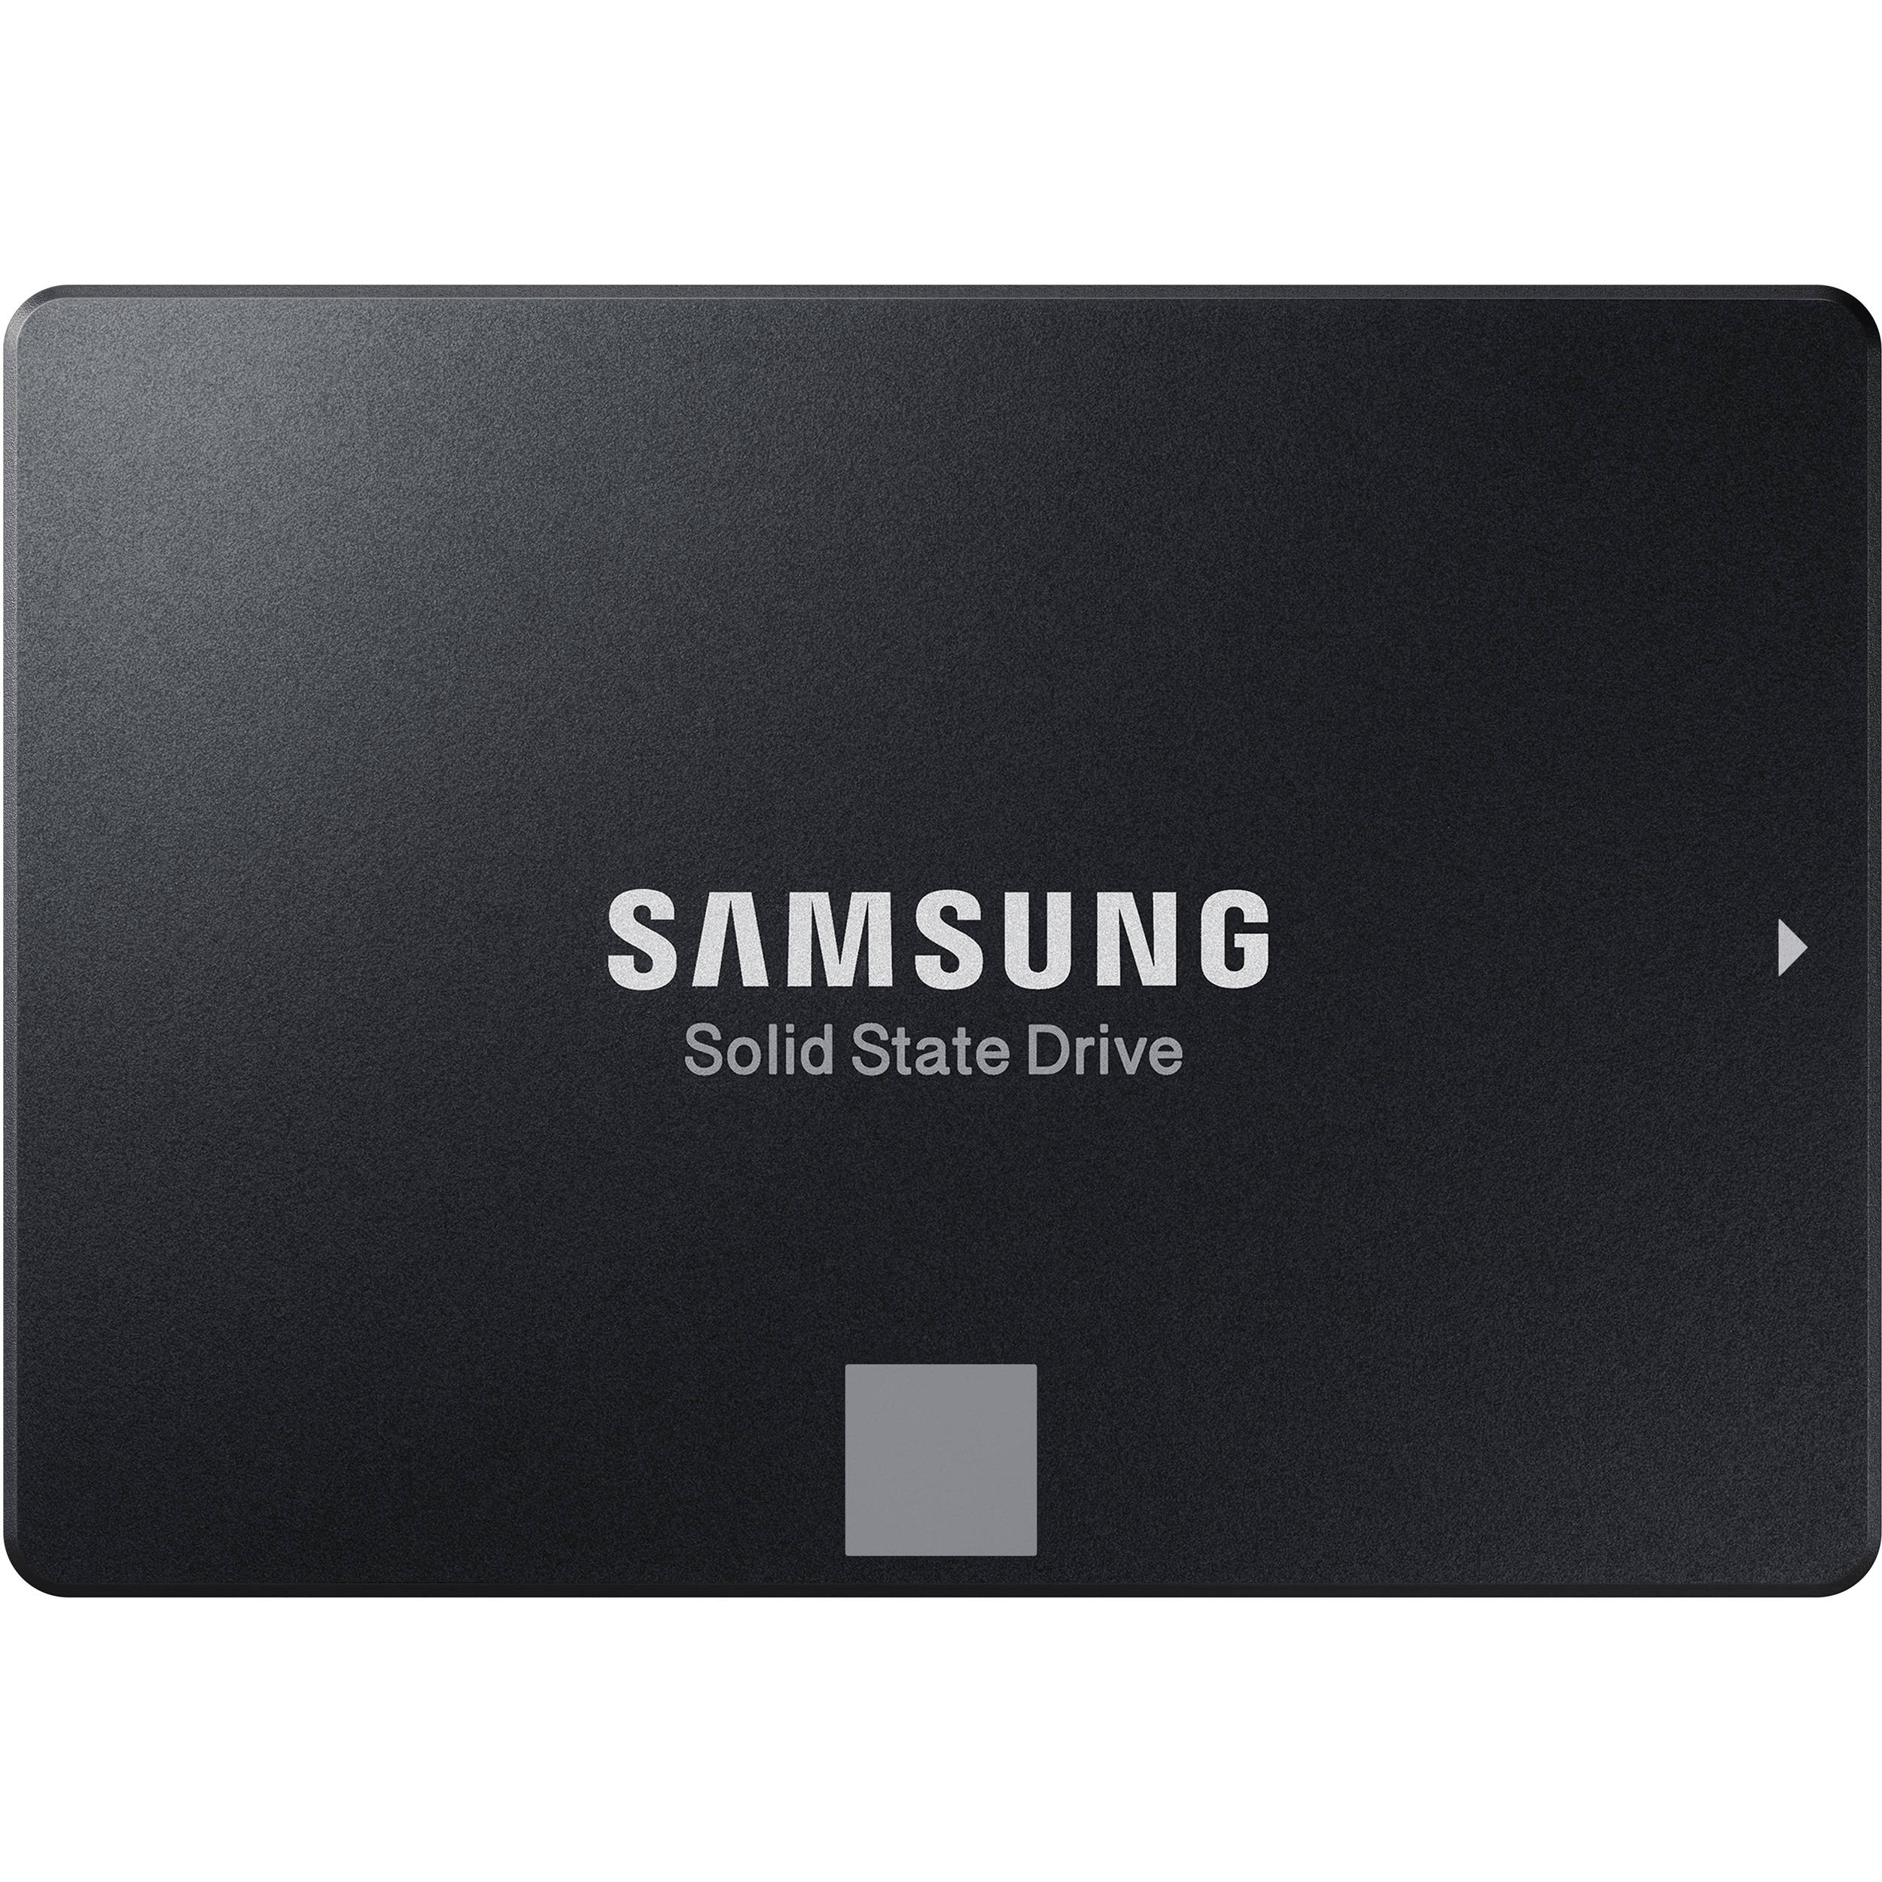
1. Introduction
Google Finance
Writing is so hard!!

Slide 5
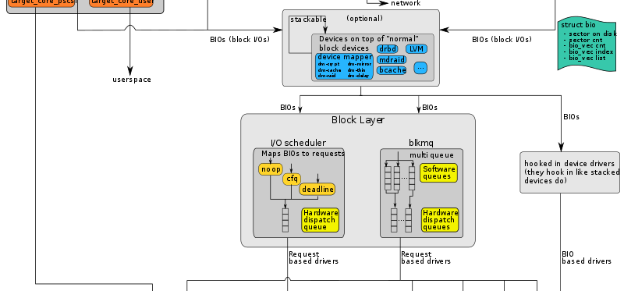
1. Introduction

Slide 6
1. Introduction
전체 처리량 개선 목표
- 병합 및 정렬 수행

Slide 7

2. Scheduler
Google Finance
2. Scheduler
1. Introduction
Performance comparison and analysis of Linux block I/O schedulers on SSD
Linux Block IO: Introducing Multi-queue SSD Access on Multi-core Systems

Slide 8
2. Scheduler
Deadline
CFQ
NOOP
BFQ

Slide 9
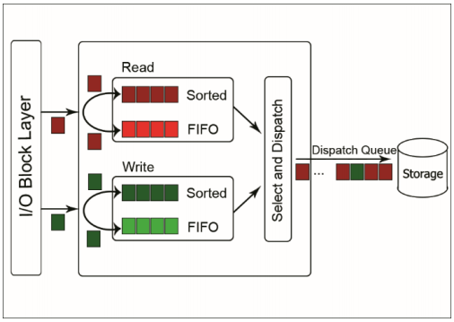
2. Scheduler
Deadline I/O schedular
I/O의 병합으로 인한 디스크 특정 부분의 기아 상태 해결
Deadline
CFQ
NOOP
BFQ

Slide 10
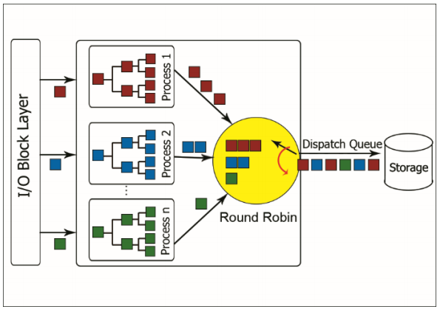
2. Scheduler
CFQ I/O schedular
프로세스 별 I/O 대역폭을 균등하게 분배
Deadline
CFQ
NOOP
BFQ

Slide 11
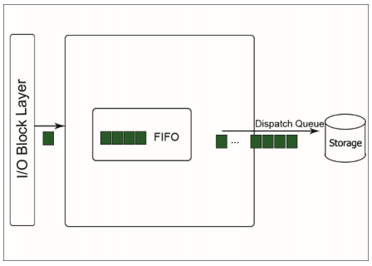
2. Scheduler
NOOP I/O schedular
거의 FIFO 상태로 진행
Deadline
CFQ
NOOP
BFQ

Slide 12
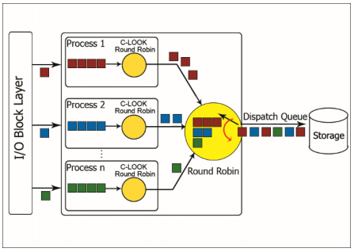
2. Scheduler
BFQ I/O schedular
CFQ기반으로 진행, 라운드 로빈을 Time 대신에 섹터 사용
Deadline
CFQ
NOOP
BFQ

Slide 13
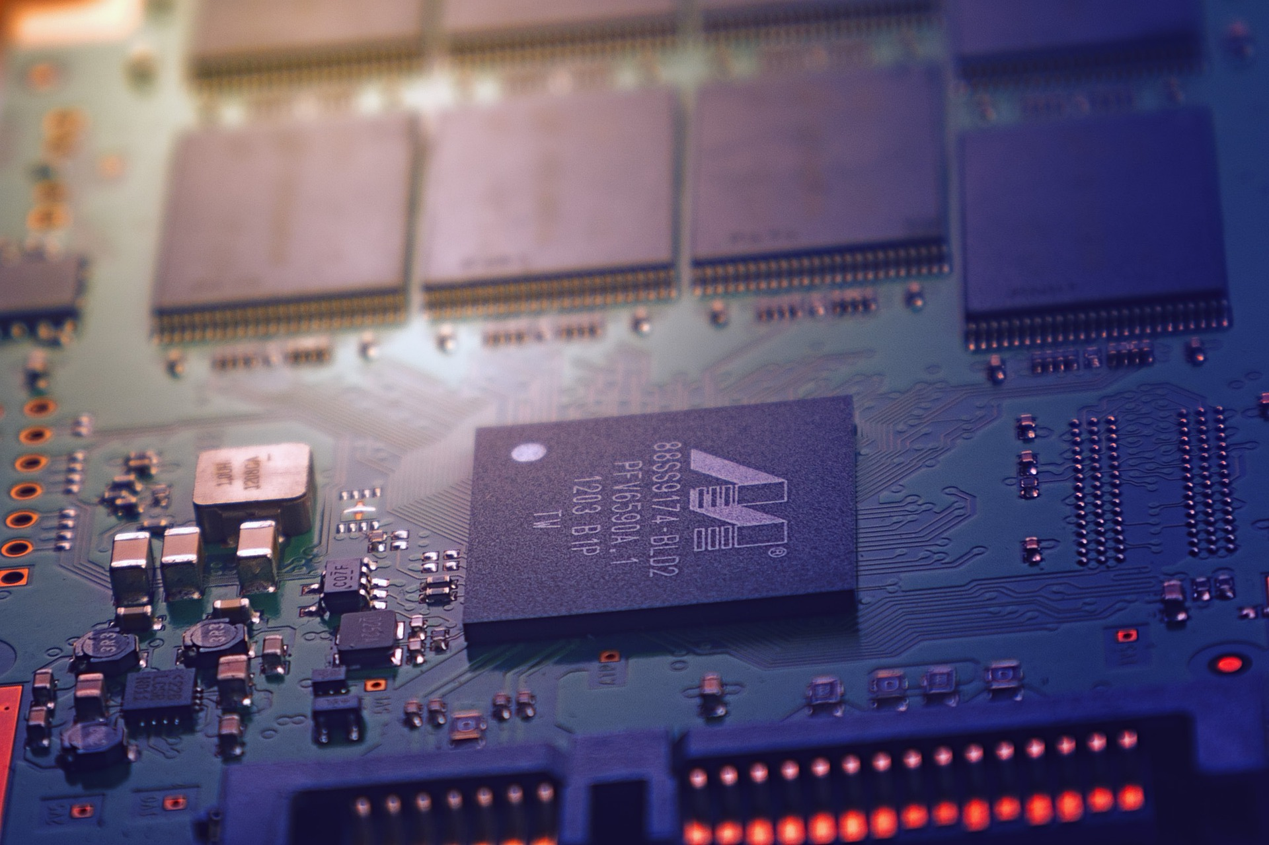
3. Analysis and Results
3. Analysis and Results
Performance comparison and analysis of Linux block I/O schedulers on SSD

Slide 14
3. Analysis and Results
Benchmark setup
ioZone
64KB chunk
64KB ~ 500MB file size
Platform
4 cores 1.90 GHz Intel i7 351U
4GB memory(256KB L2 cache, 4MB L3)
a 240GB Sandisk U100 SATA 600
EXT4

Slide 15
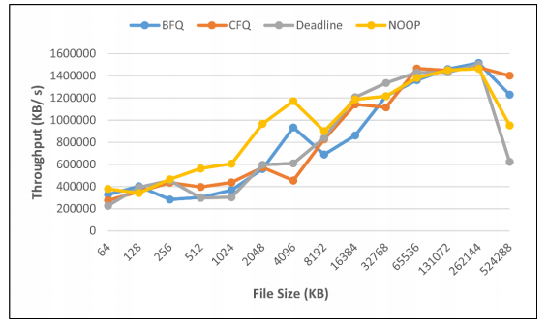
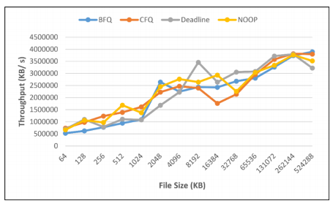
3. Analysis and Results
Write test results
Rewrite test results

Slide 16
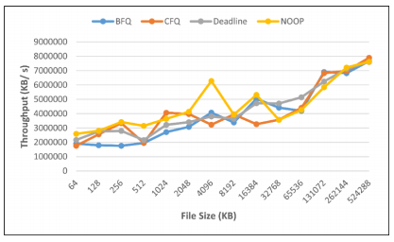
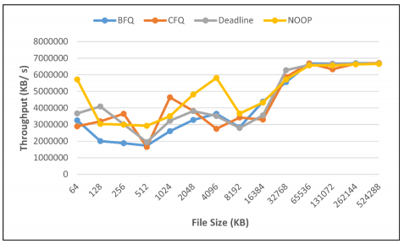
3. Analysis and Results
Read test results
Reread test results

Slide 17
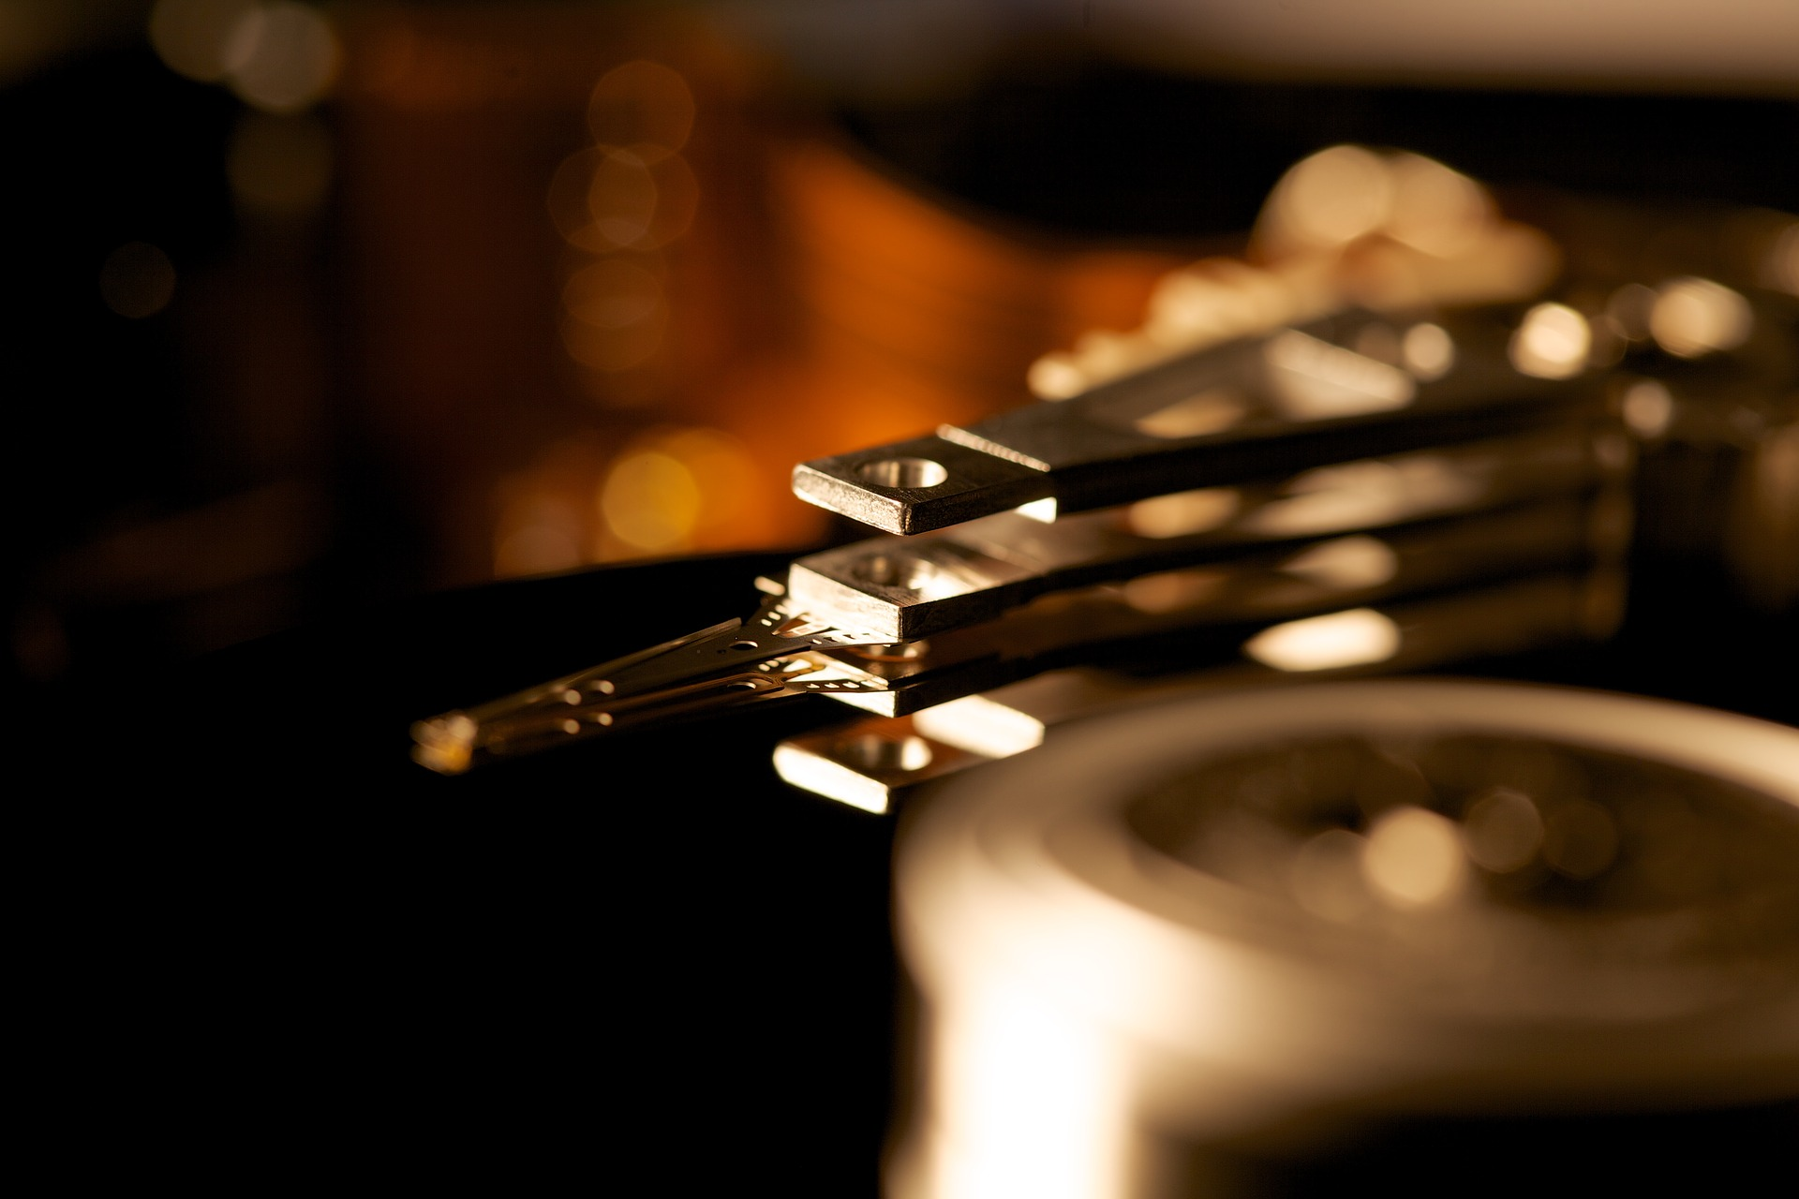
4. Conclusion
4. Conclusion
Performance comparison and analysis of Linux block I/O schedulers on SSD

Slide 18
4. Conclusion
Conclusion
CFQ 스케줄러는 균형 잡힌 I/O 액세스가 필요하고 프로세스 우선 순위가 필요하지 않은 시스템에 적합
Deadline 스케줄러는 읽기 집약적 인 작업에 적합
Noop은 클라우드 시스템에 적합
BFQ는 대화형 시스템에 적합
Google Finance

Slide 19
Performance comparison and analysis of Linux block I/O schedulers on SSD
Yunus Ozen, Abdullah Yildirim.
Thank you!
2021. 01. 12
Presentation by Lee, Sounghyoun
leesh812@dankook.ac.kr

